Slide 1
Predicting
FLIGHT DELAYS
W261 Final Project Phase I – Group 11 – March 13, 2022
Jeff Adams, Jenny Conde, Dante Malagrino, Joy Moglia, Ram Senthamarai
Notes:
[JEFF]
We are a business that seeks to predict flight delays and sell these predictions to airlines. This is an important problem because flight delays cause billions of dollars in losses to airlines each year.

Slide 2
Predict a 15-min or longer departure delay, given information available 2 hours before the scheduled departure
Flight Delay Prediction as a Binary Classification Problem
Notes:
[JEFF]
Using historical flight and weather information, our model will predict a 15-minute or longer delay for a departing flight 2 hours before departure.
—--------------
Other notes:
Target ___ market first, which helps us develop an evaluation metric for our model.
OLD:
Delayed flights have a financial and emotional impact on passengers, airlines and airports. Several studies have quantified the financial impact in terms of billions of dollars, just in the United States. While avoiding delays can be impossible, improving the ability to predict them can help mitigate consequences.

Slide 3
Business Problem and Metrics
False Positives are more dangerous than False Negatives
A False Negative is not worse than the status quo (unpredictable delay)
(1+β²) · (Precision · Recall)
F_{β} =
(β² · Precision + Recall)
Notes:
[DANTE]
“If you can’t measure it, it doesn’t perform.” - Airlines will be more impacted by False Positives than Negatives; so we have chosen a F-beta score that weights precision over recall. Predicting on-time departure for a delayed flight would be no different than the status-quo, while predicting delay for a flight that leaves on-time could have damaging consequences in the event of containing measures being taken in response to our prediction.
—------
Our airline clients want to avoid false positives, so we use a F-beta score that weights precision higher than recall.
High false positive rate = delay mitigation processes might be more expensive than just living with the delay

Slide 4
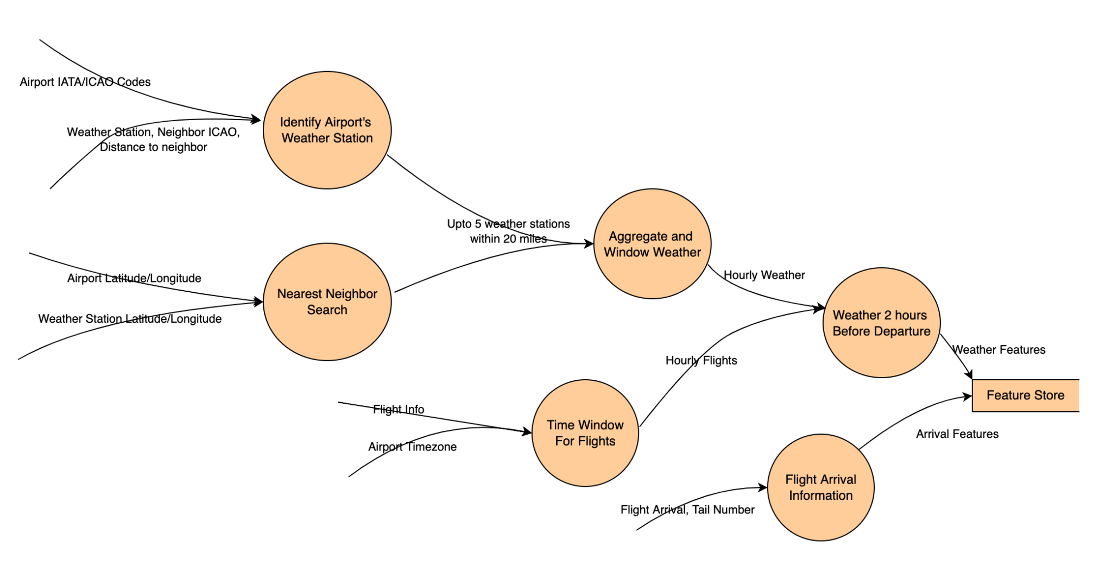
Datasets
Notes:
[RAM]
This graphic illustrates how we will be joining multiple datasets. Our combined dataset has over 30 million flights between about 370 airports in the United States and 40 million weather observations from 700 weather stations.
Key points (for any questions):
Addressing Scale
12,000 weather stations to 700 weather stations near 372 airports.
630 million observations to about 40 million observations.
31 million flights between 372 airports
Joins
IATA <-> ICAO, IANA for TZ.
Ball Tree based KNN using latitude and longitude. Upto 5 weather stations within a 20 mile radius.
Date + hour of day as partition key.

Slide 5
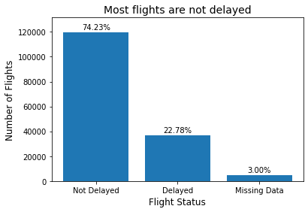
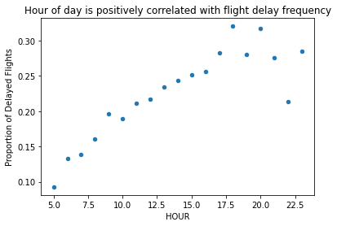
Exploratory Data Analysis
Notes:
[JENNY]
An initial exploration of the data shows an unbalanced dataset, with the majority of flights being on time. Also, flights later in the day tend to be delayed more frequently. This could be the result of delay propagation, which is not surprising since delayed flight arrival is a common cause for delayed departure.
—---
Target class is unbalanced
Flights later in the day tend to be more delayed
Flight delays tend to grow towards the end of the day

Slide 6
Achievements and Plan
☑
Dataset full join & deeper EDA
2020/2021 data import
Data cleanup (outliers, missing values,...)
Feature engineering (stage I)
Baseline classification model (stretch)
Question Formulation
Definition of key metrics
Exploratory Data Analysis
Dataset join strategy
Initial implementation of data pipeline
☑
☑
☑
☑
Notes:
[JOY]
We made good progress this week. In Phase II, we will join the datasets, do more EDA and data preprocessing, perform feature engineering, and run a baseline model if time allows.

Slide 7
THANK YOU

